Slide 1
Inventory Optimization
Product and Customer Clustering Based on Demand Patterns
NGUYEN, Duong Tung | Gunwoo Park | Hyeonji Jung
Statistical Data Mining | IMEN472 | Mid-Term Presentation

Slide 2
Outline of Contents
Introduction
Data and Preprocessing
Analysis
Results
Roadmap

Slide 3
Introduction
Project Objectives
Domain Background
Notes:
Business characteristics and
Business objective to achieve
(Data mining objectives are for the next section)

Slide 4
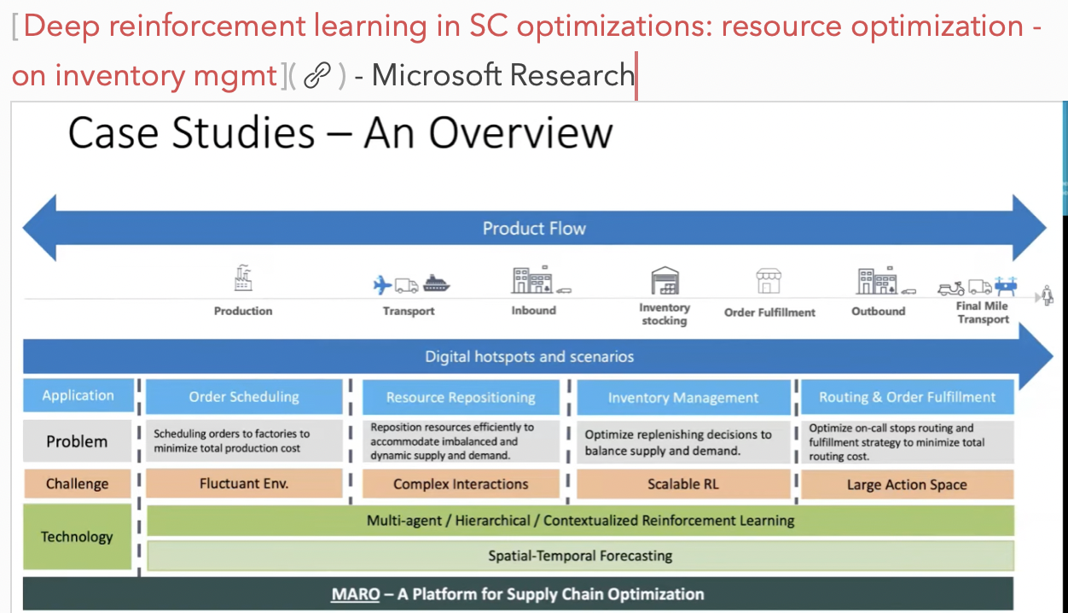
Introduction - Background
Overview of Supply Chain Processes

Slide 5
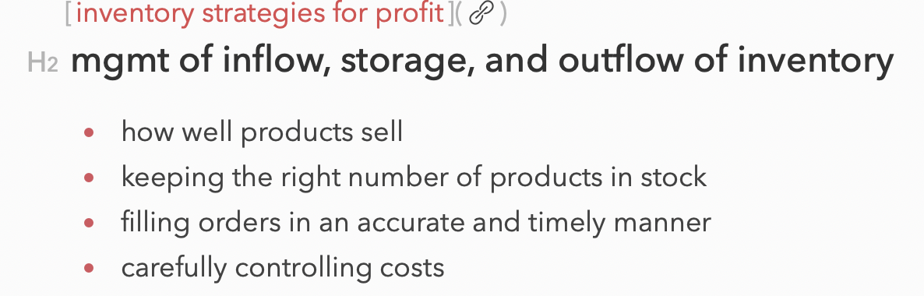
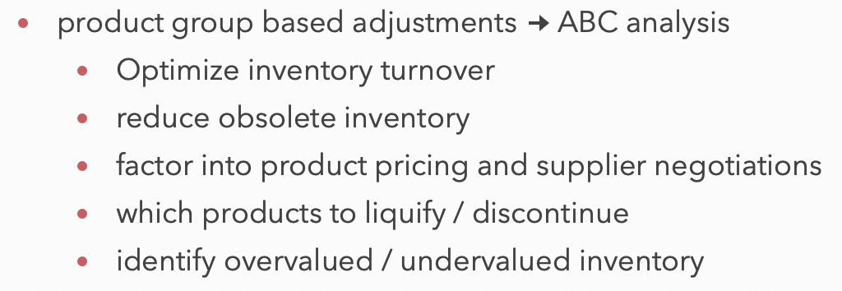
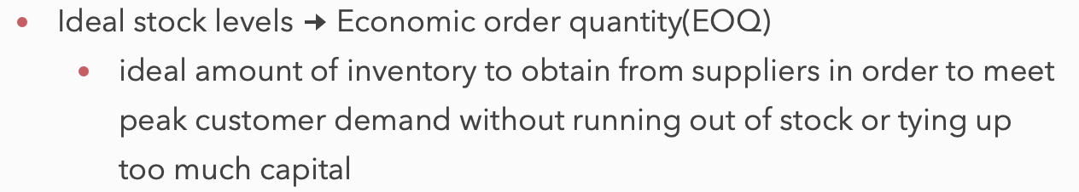
Introduction - Background
AS-IS: Inventory Management Solutions
Overstock / Understock

Slide 6
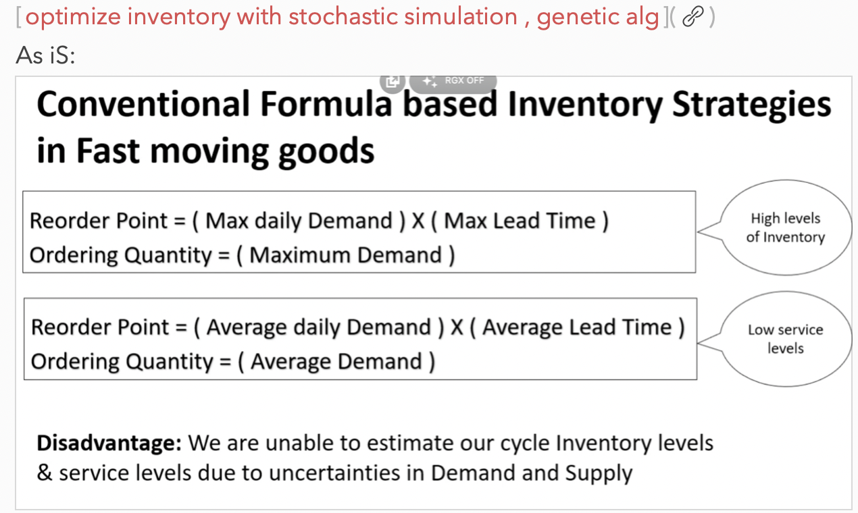
Introduction - Background
AS-IS: Conventional Inventory Management Solution

Slide 7
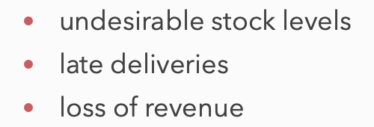
Introduction - Background
AS-IS: Metrics to Avoid

Slide 8
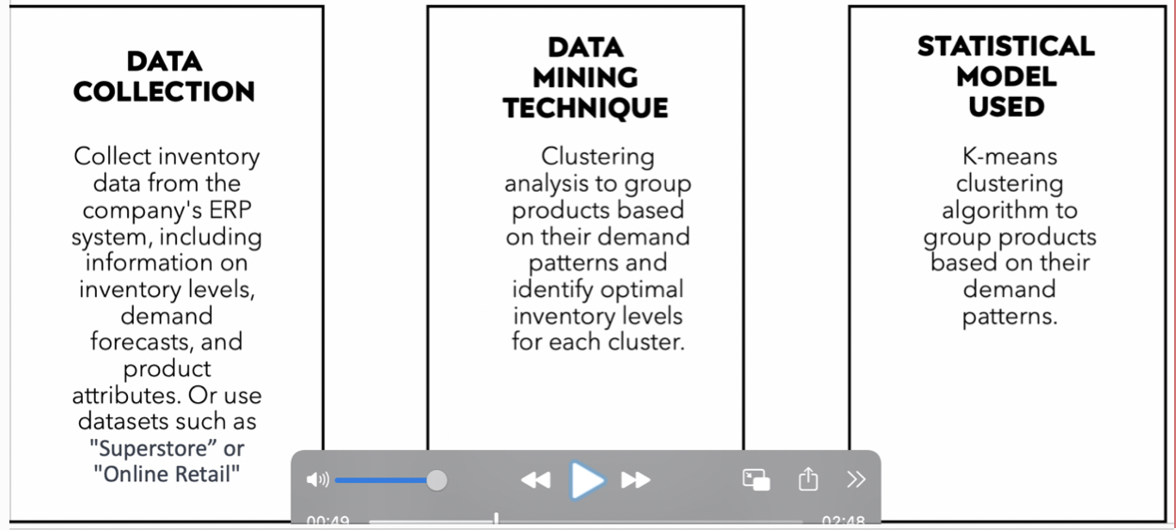
Introduction - Objective
Overview
Notes:
1. Background(Domain)

Slide 9
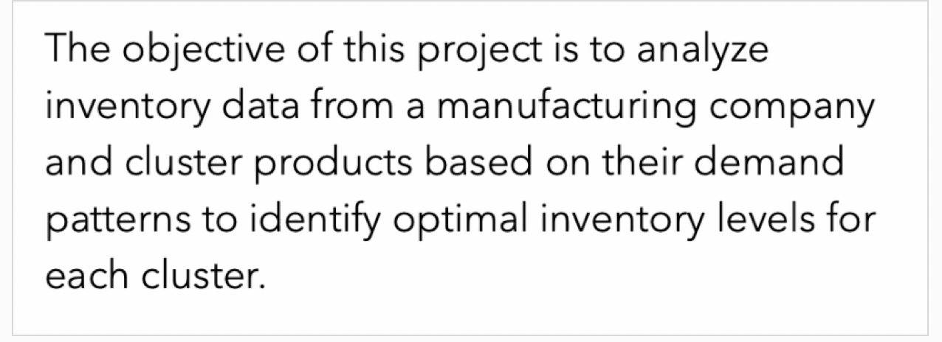
Introduction - Objective
Summary of Objectives
- based on attributes(sales, consume rate..) -> categorize -> biz implications
- define product groups with similar demand patterns
- define optimal inventory levels for each cluster based on demand patterns

Slide 10
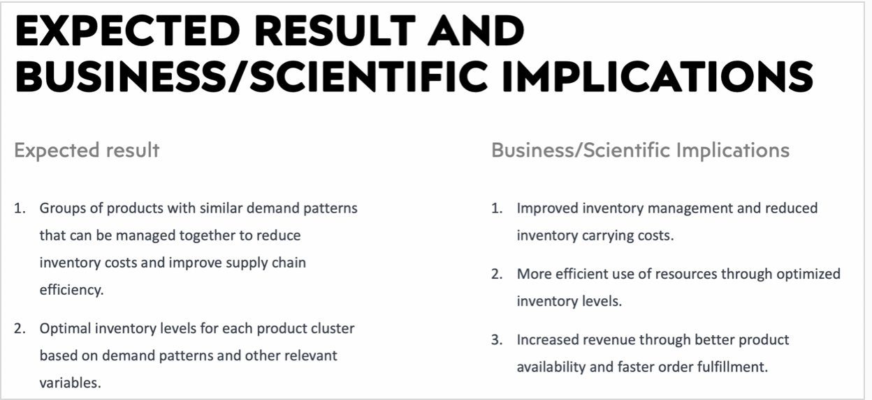
Introduction - Objective
Implications
Notes:
1. Background(Domain)

Slide 11
Data
Data Description
Preprocessing
Prep for Feature Selection

Slide 12
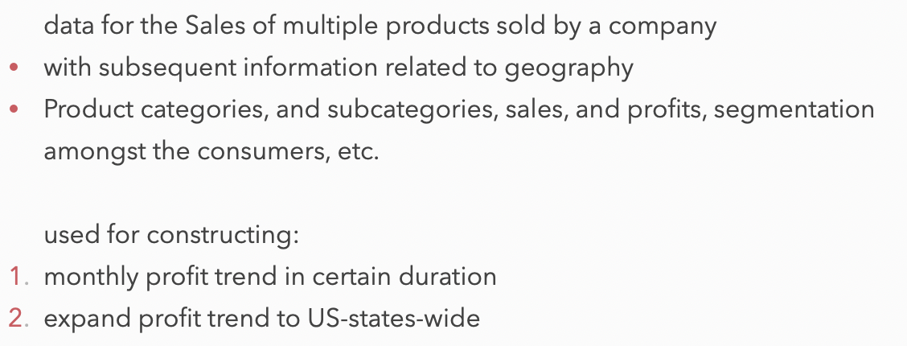
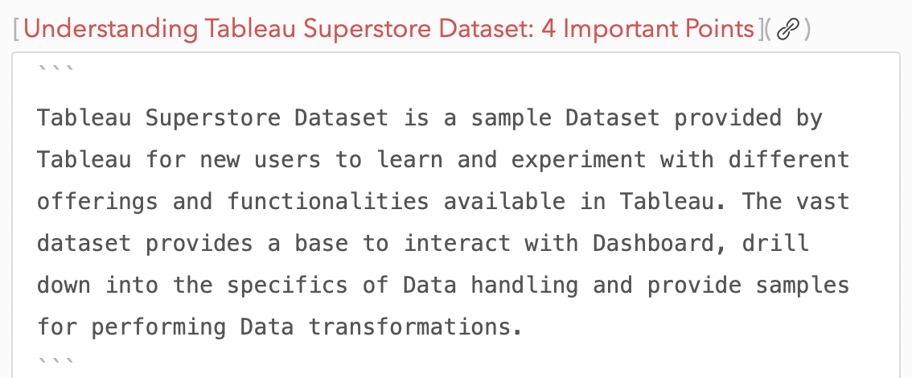
Data - Description
Tablueau Superstore Dataset

Slide 13
Data - Preprocessing
Setting Objectives Based on Profiling Results
1. Missing Values
2. Variable Type Corrections
3. Encoding
4. Distributions of Variables
Notes:
2. Data
1. Preprocessing
1. missing values
2. variable type corrections
3. encoding
4. distributions of the variables
2. preprocessing for feature selection
1. identify meaningful features
2. encoding and scaling
3. outlier detection for performance improvement
4. anomaly detection for validity of the dataset

Slide 14
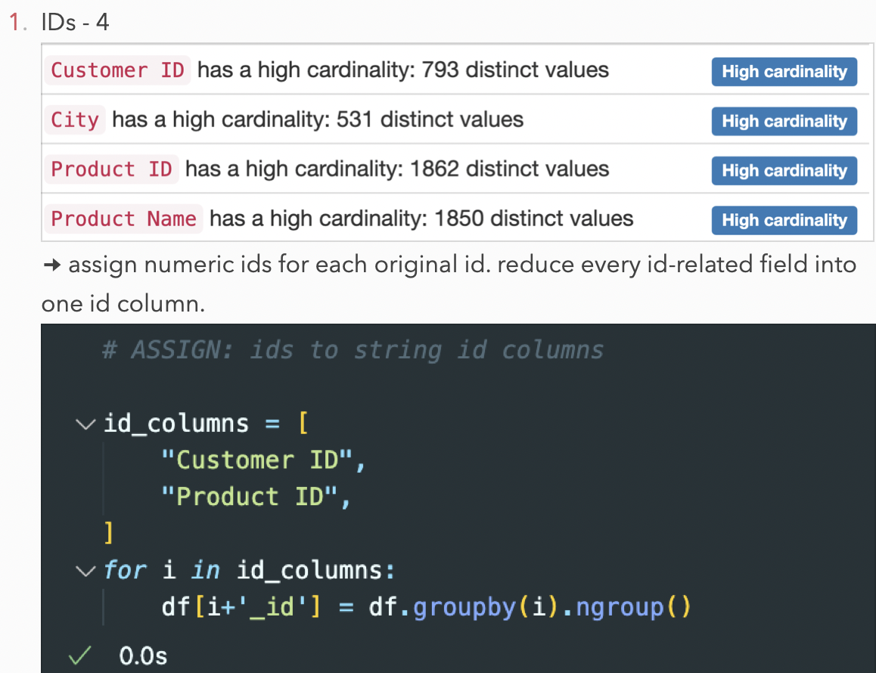
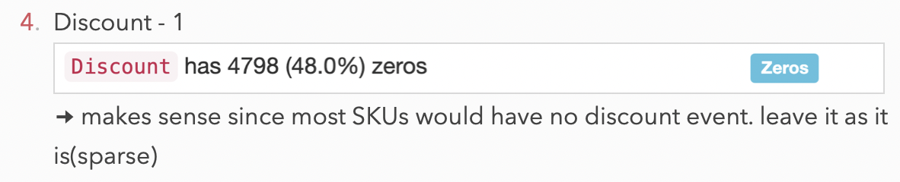
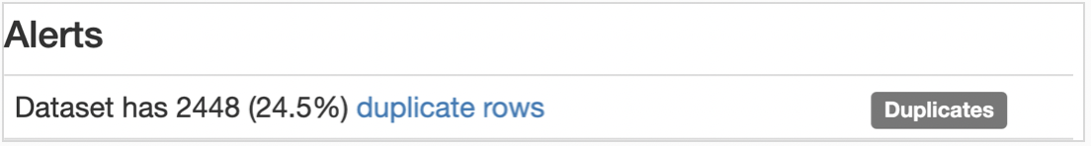
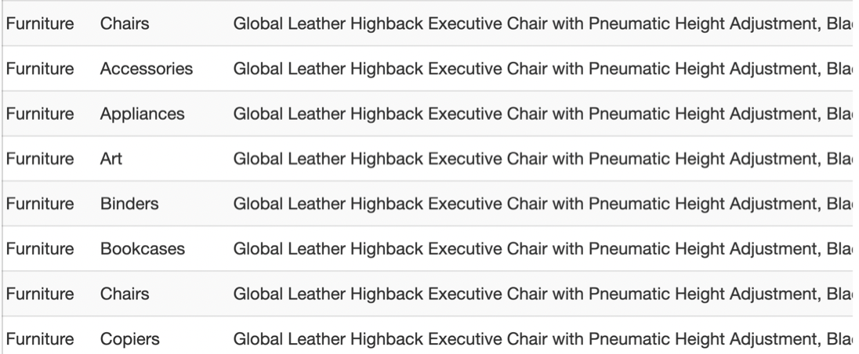
Data - Preprocessing
High Cardinality | Sparsity | Duplicate Rows
Notes:
2. Data
1. Preprocessing
1. missing values
2. variable type corrections
3. encoding
4. distributions of the variables
2. preprocessing for feature selection
1. identify meaningful features
2. encoding and scaling
3. outlier detection for performance improvement
4. anomaly detection for validity of the dataset

Slide 15
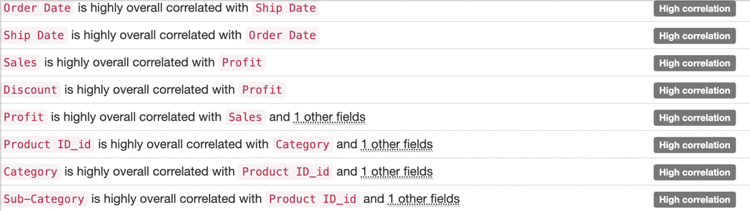
Data - Preprocessing
High Correlations
Notes:
2. Data
1. Preprocessing
1. missing values
2. variable type corrections
3. encoding
4. distributions of the variables
2. preprocessing for feature selection
1. identify meaningful features
2. encoding and scaling
3. outlier detection for performance improvement
4. anomaly detection for validity of the dataset

Slide 16
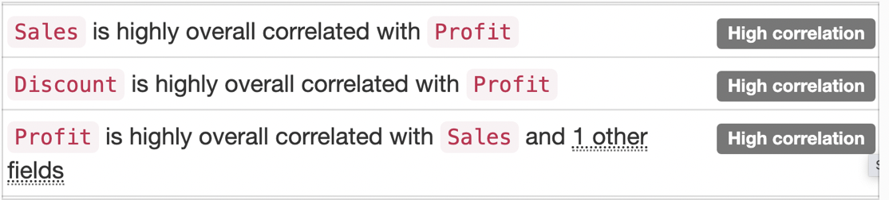
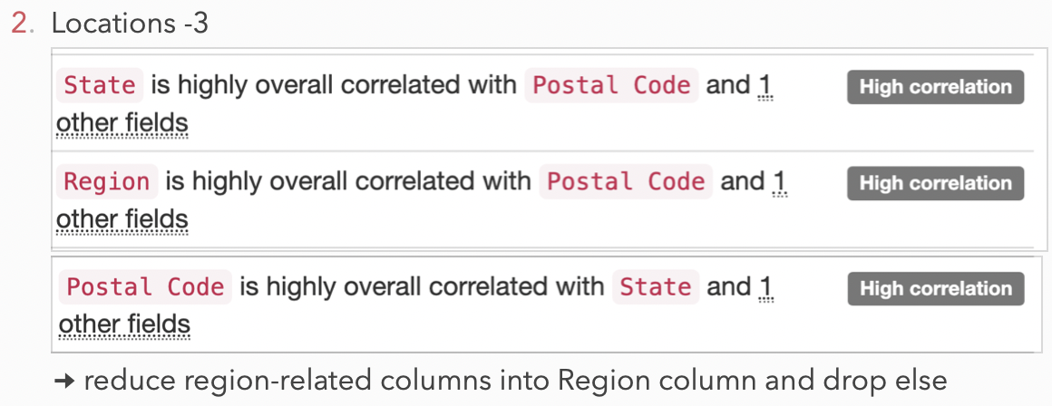
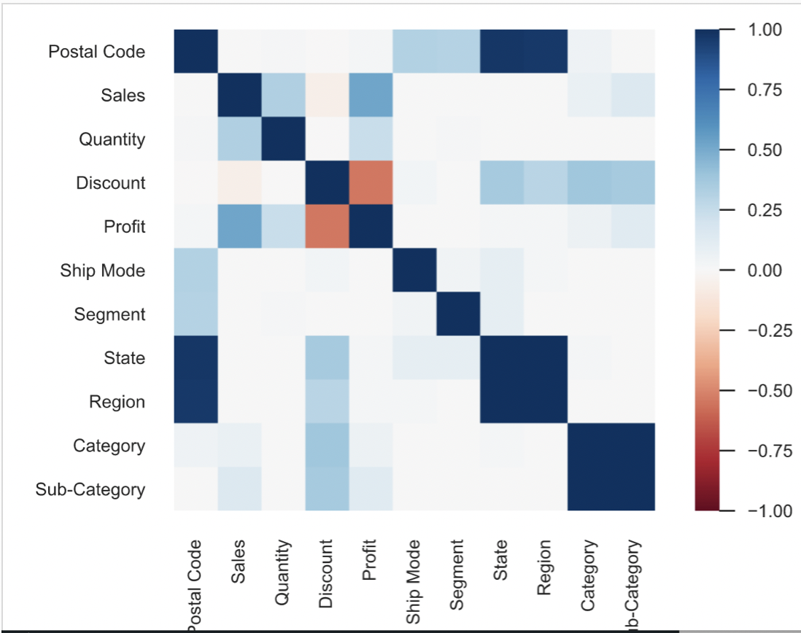
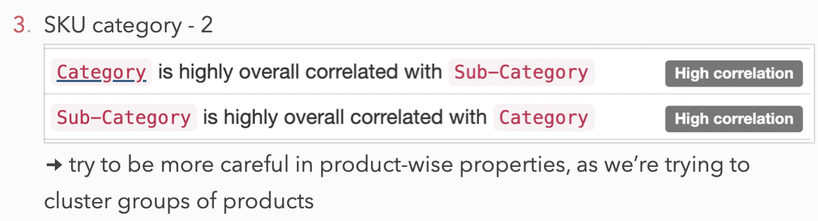
Data - Preprocessing
High Correlations
Notes:
2. Data
1. Preprocessing
1. missing values
2. variable type corrections
3. encoding
4. distributions of the variables
2. preprocessing for feature selection
1. identify meaningful features
2. encoding and scaling
3. outlier detection for performance improvement
4. anomaly detection for validity of the dataset

Slide 17
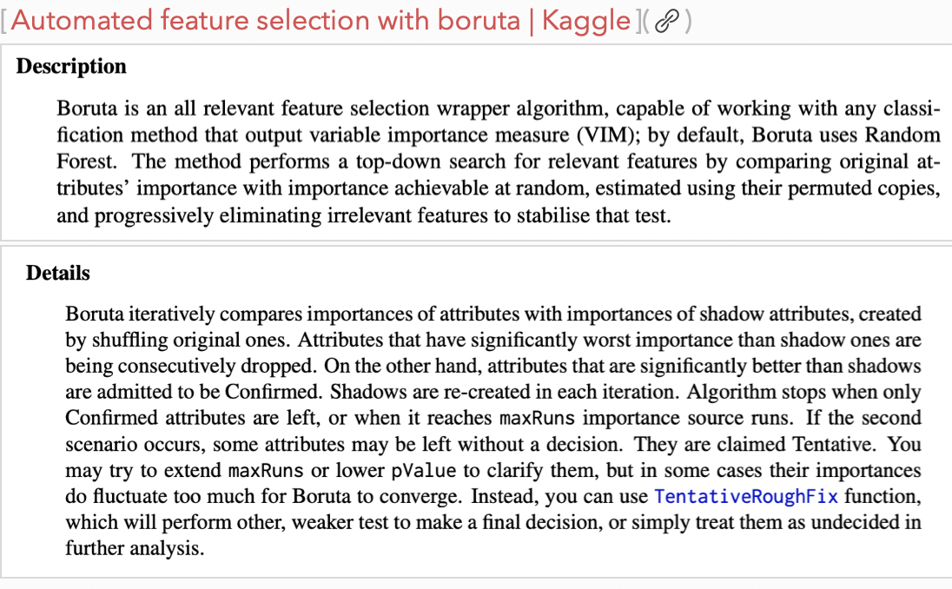
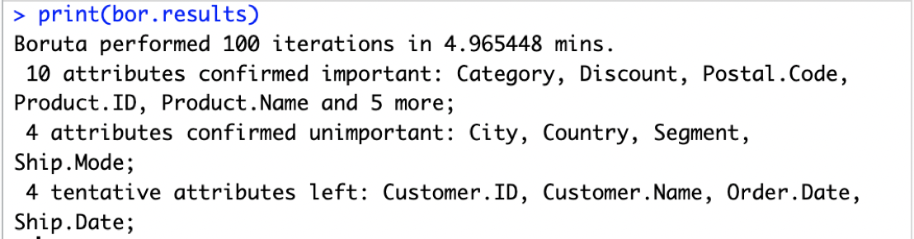
Data - Prep for Feature Selection
Boruta: preliminary feature importance check
Notes:
2. Data
1. Preprocessing
1. missing values
2. variable type corrections
3. encoding
4. distributions of the variables
2. preprocessing for feature selection
1. identify meaningful features
2. encoding and scaling
3. outlier detection for performance improvement
4. anomaly detection for validity of the dataset

Slide 18
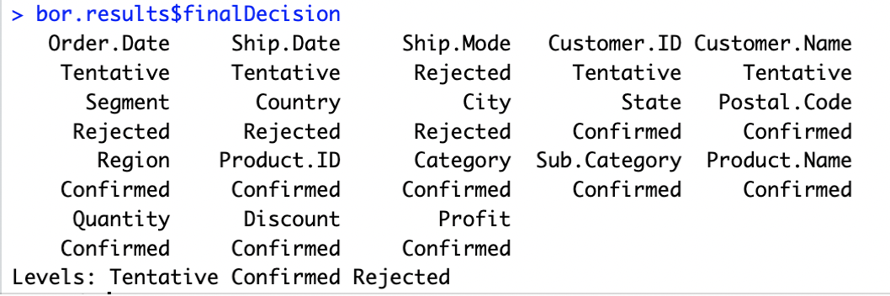
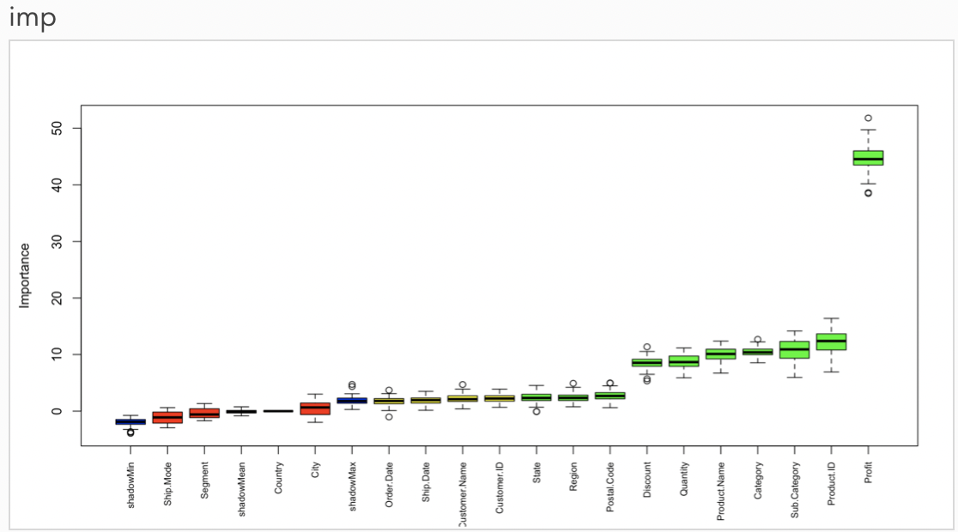
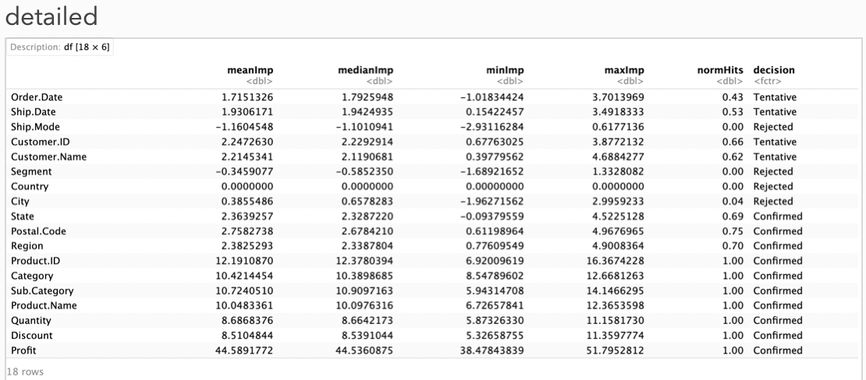
Data - Prep for Feature Selection
Boruta: preliminary feature importance check
Notes:
2. Data
1. Preprocessing
1. missing values
2. variable type corrections
3. encoding
4. distributions of the variables
2. preprocessing for feature selection
1. identify meaningful features
2. encoding and scaling
3. outlier detection for performance improvement
4. anomaly detection for validity of the dataset

Slide 19
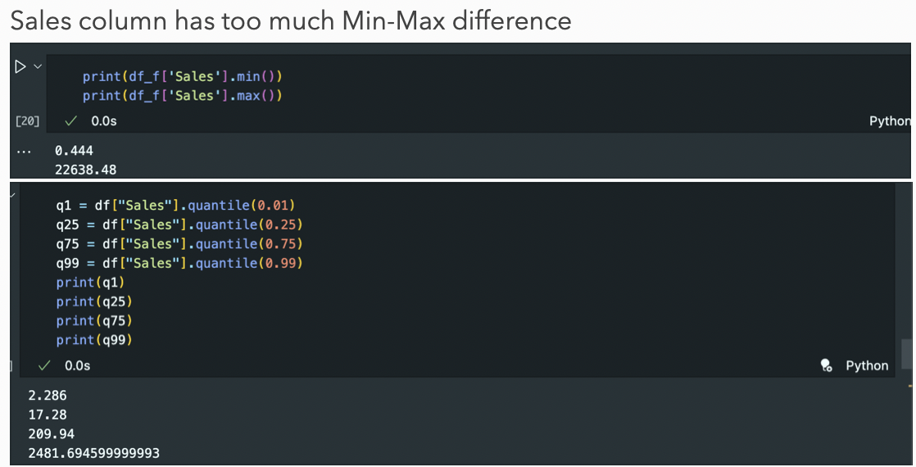
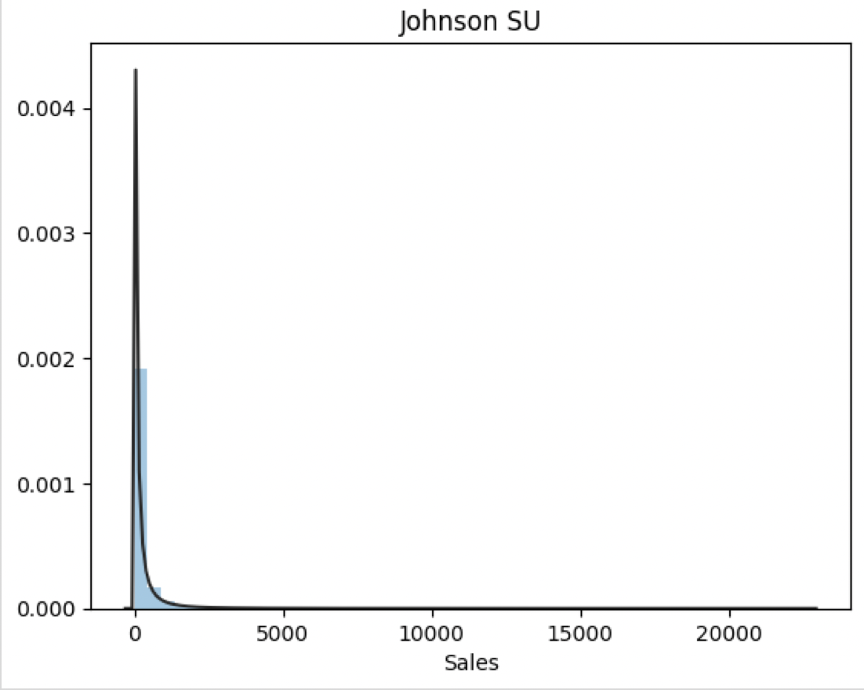
Data - Distribution of Features
Understanding Feature Characteristics
Notes:
2. Data
1. Preprocessing
1. missing values
2. variable type corrections
3. encoding
4. distributions of the variables
2. preprocessing for feature selection
1. identify meaningful features
2. encoding and scaling
3. outlier detection for performance improvement
4. anomaly detection for validity of the dataset

Slide 20
Analysis
Methods Introduction
Rough EDA
Feature Selection

Slide 21
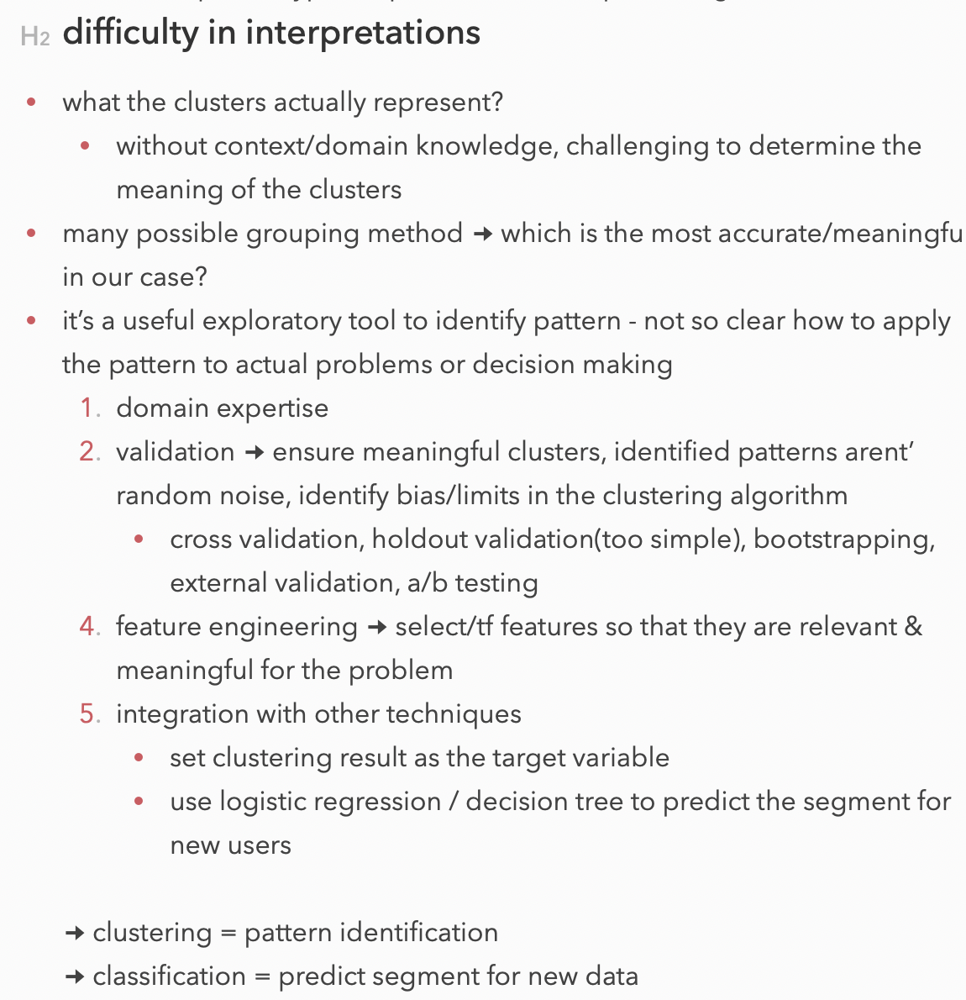
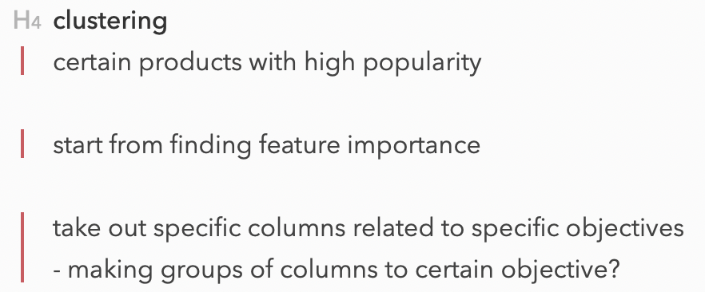
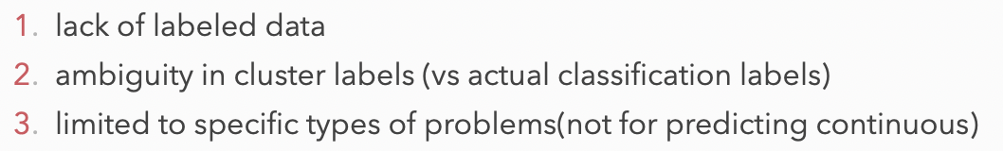
Analysis - Methods
Overview: Clustering Method

Slide 22
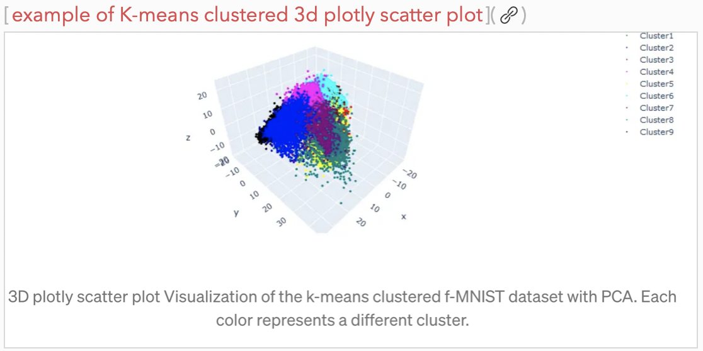
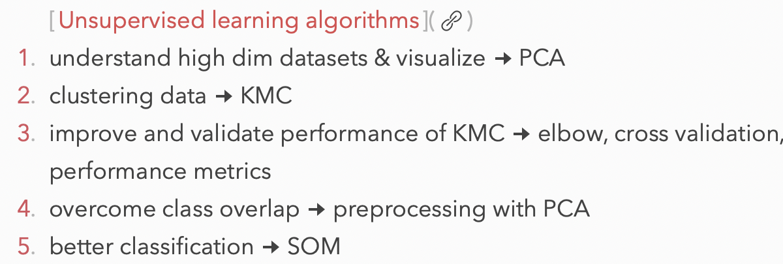
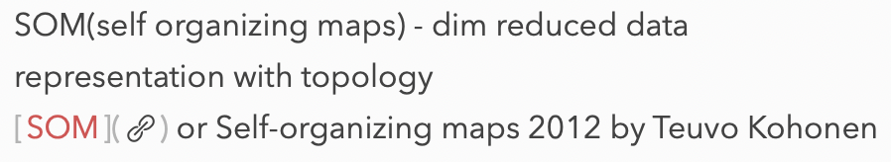
Analysis - Methods
Overview: Analysis Methods

Slide 23
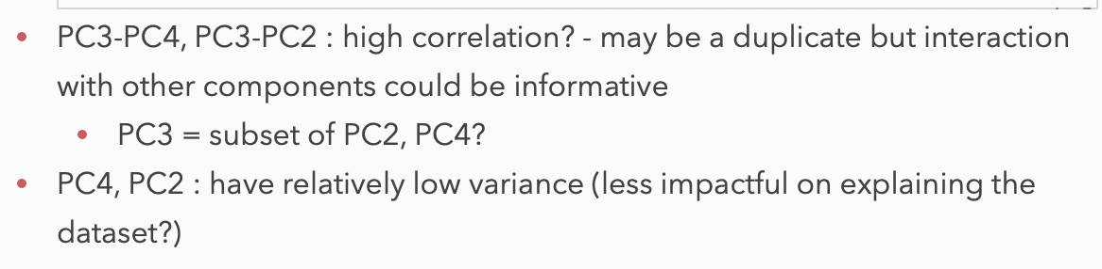
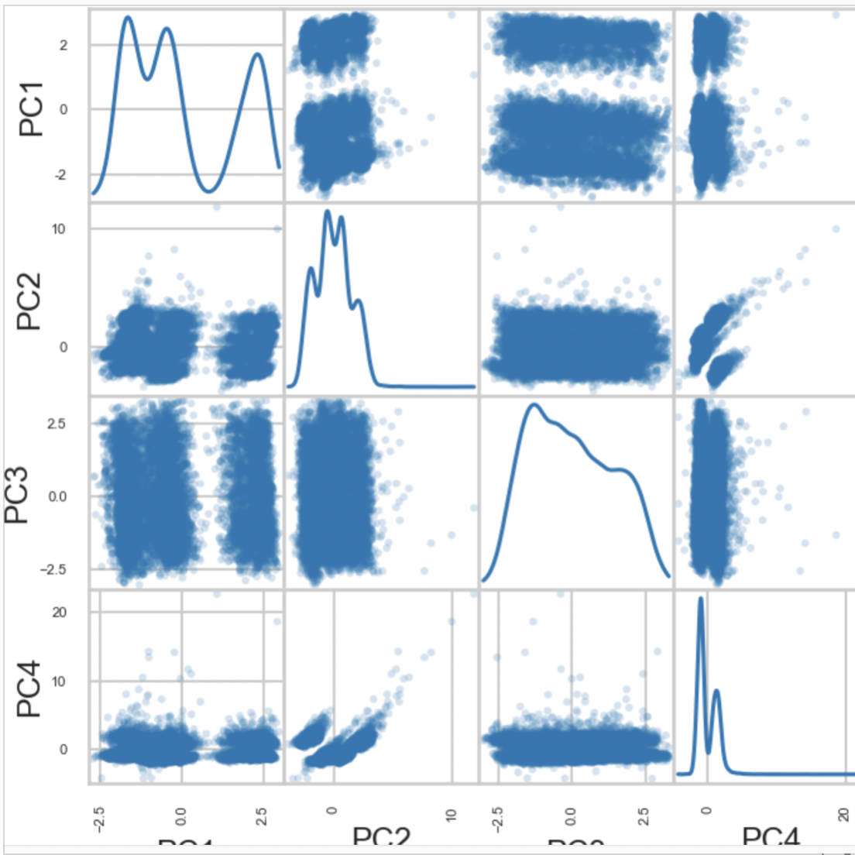
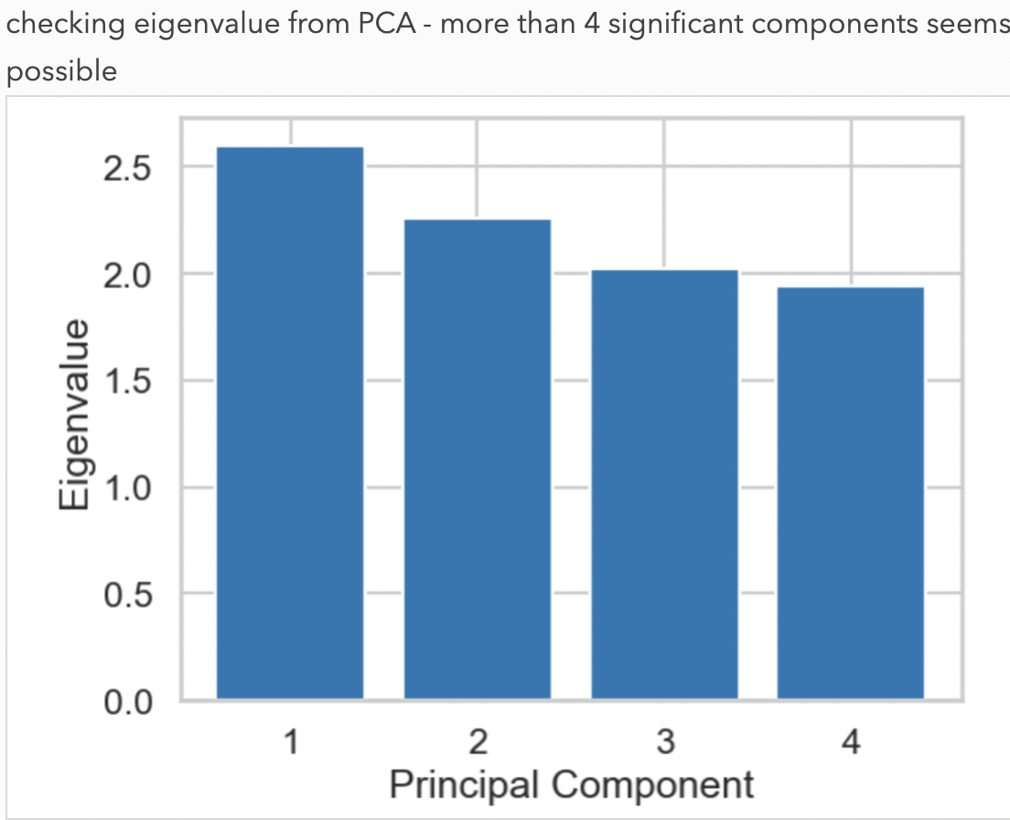
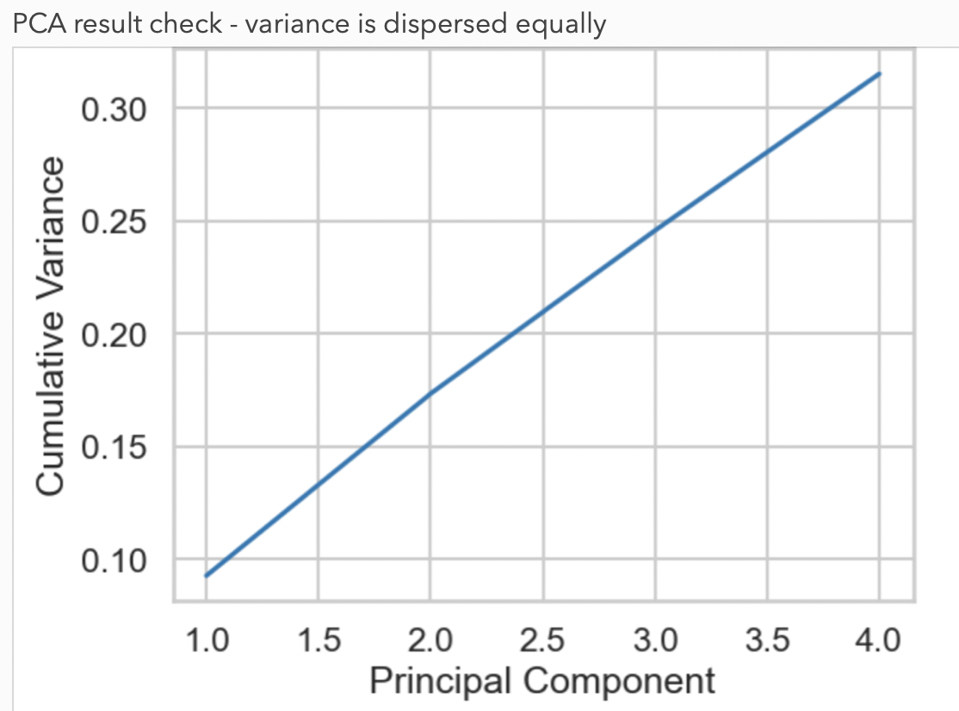
Analysis - Rough EDA
Scatter Plots with PCA Components

Slide 24
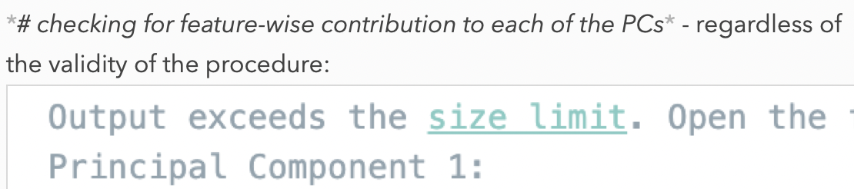
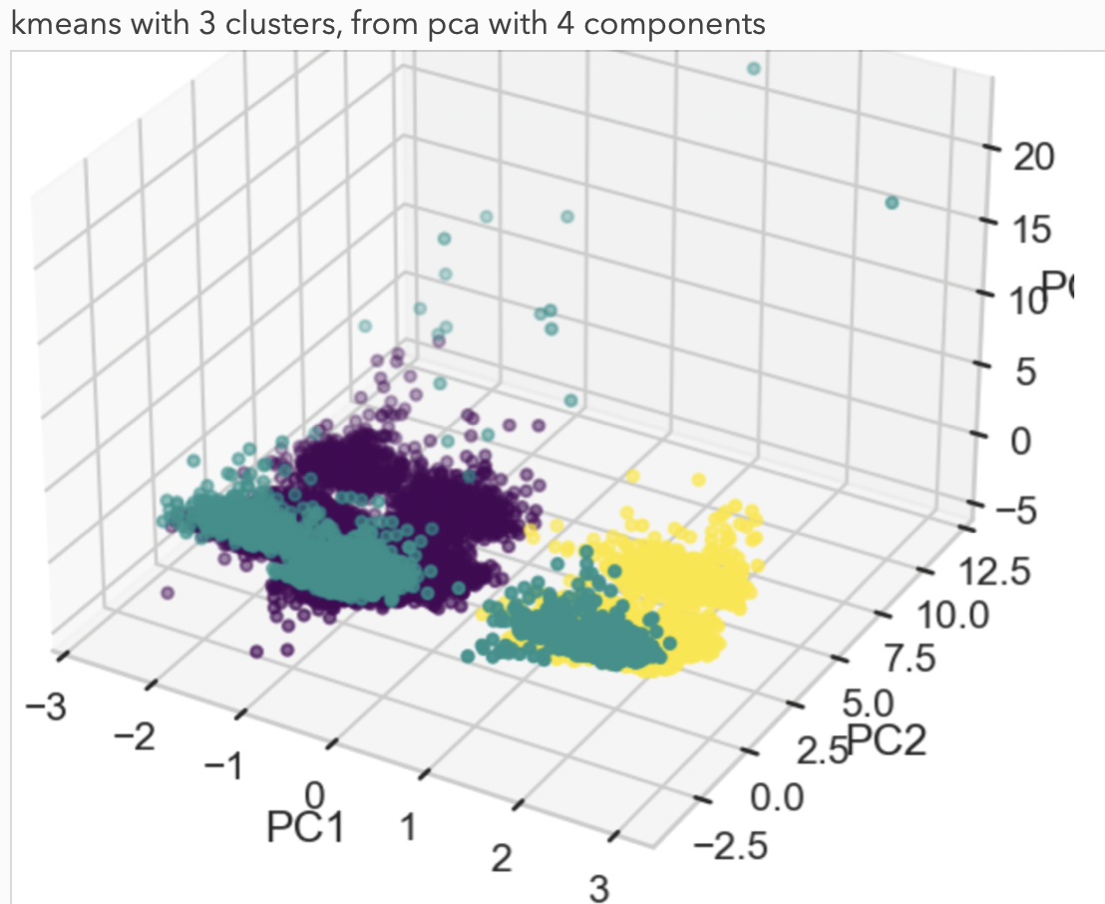
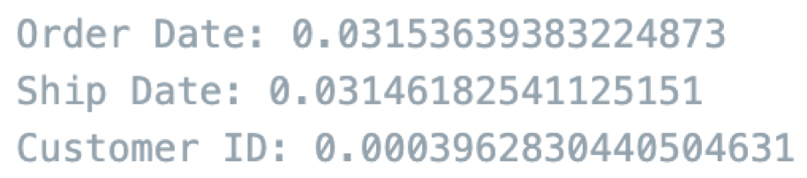
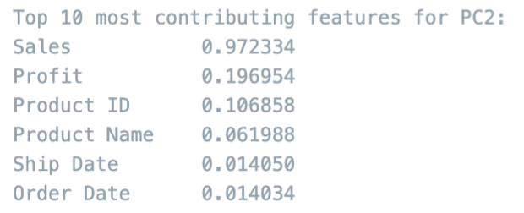
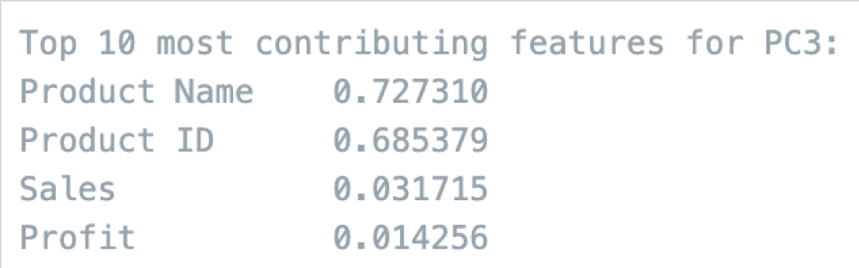
Analysis - Rough EDA
K-Means Clustering with PCA Components

Slide 25
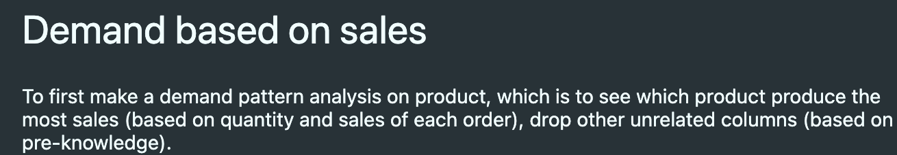
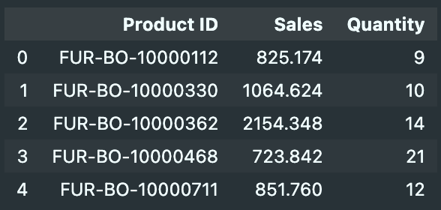
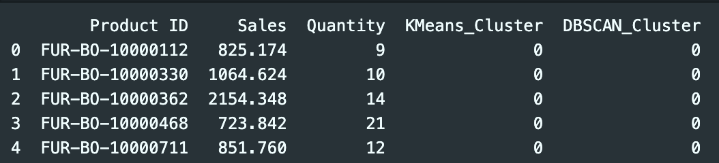
Analysis - With Feature Selection
Product/Customer Segmentation: Demand based on “Sales”

Slide 26
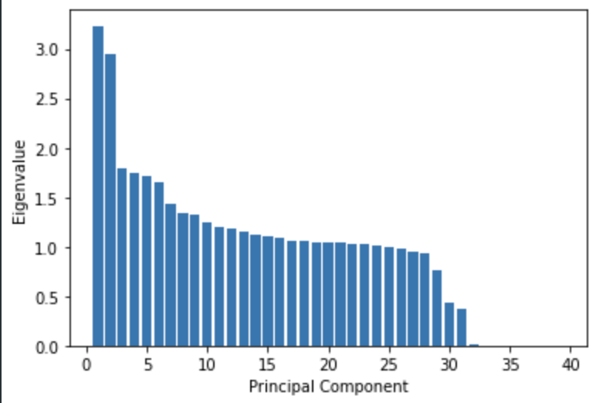
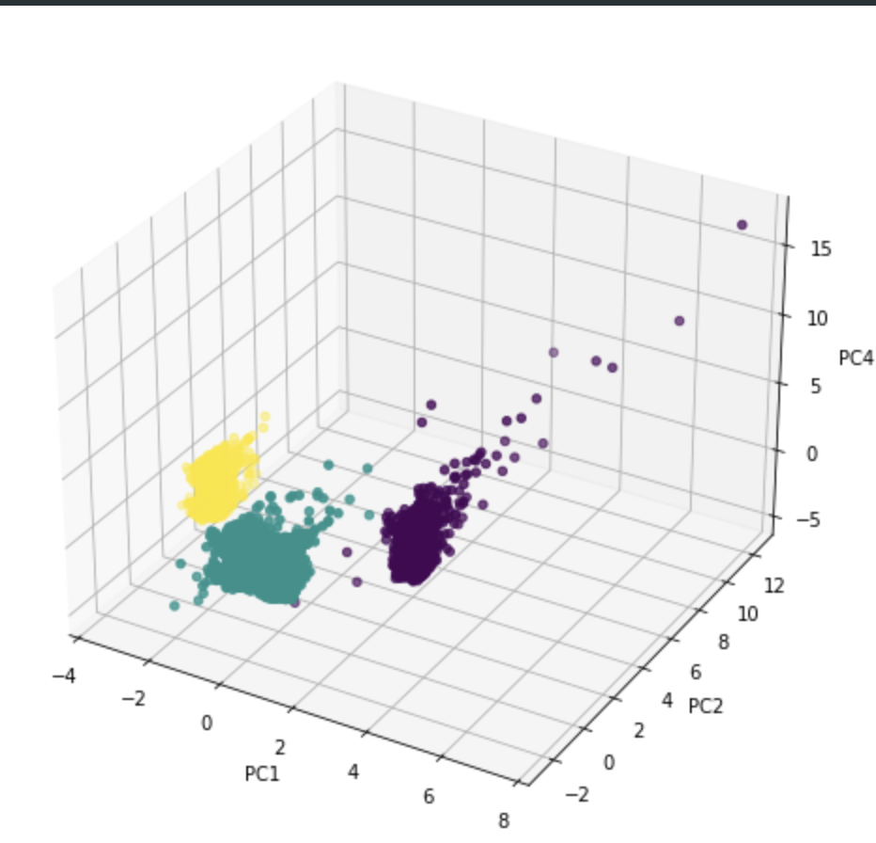
Analysis - Model Comparisons
PCA-based clustering

Slide 27
Analysis - Model Comparisons
Check for Product Uniqueness Reflected in Cluster Separations

Slide 28
Analysis - Model Comparisons
Check for Product Uniqueness Reflected in Cluster Separations

Slide 29
Results
Rough EDA
Feature-Selected EDA
Model Comparisons

Slide 30
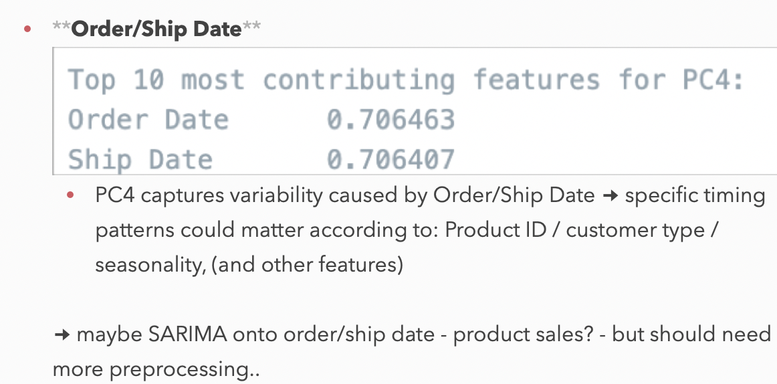
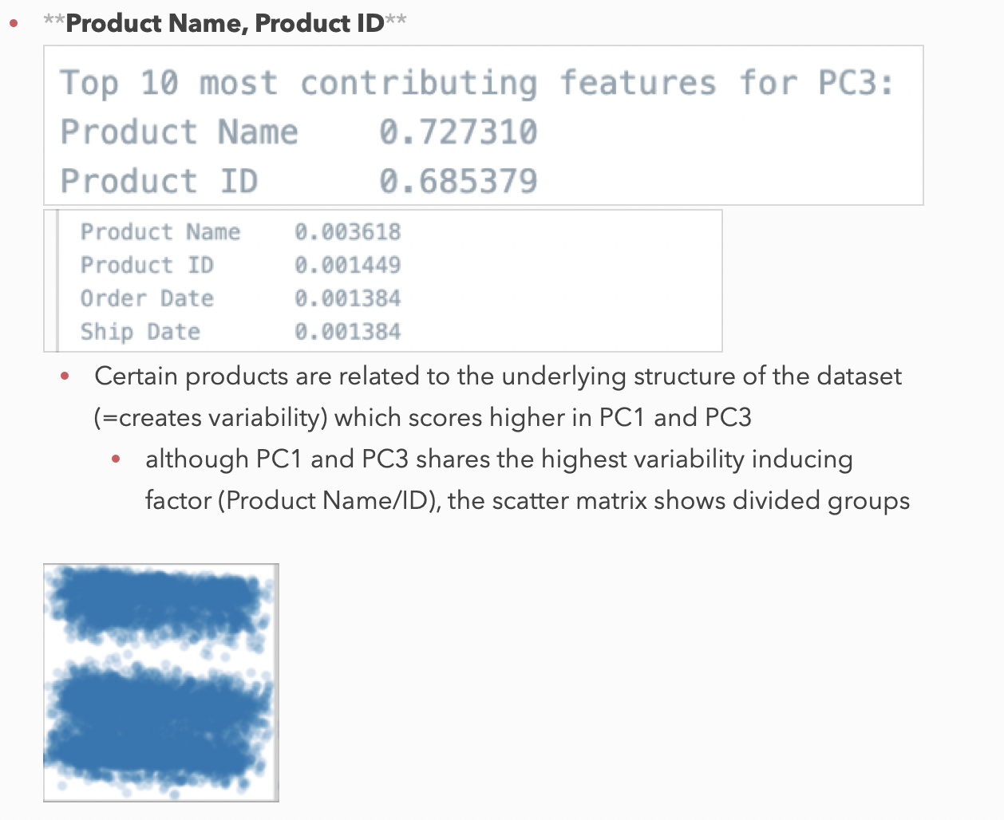
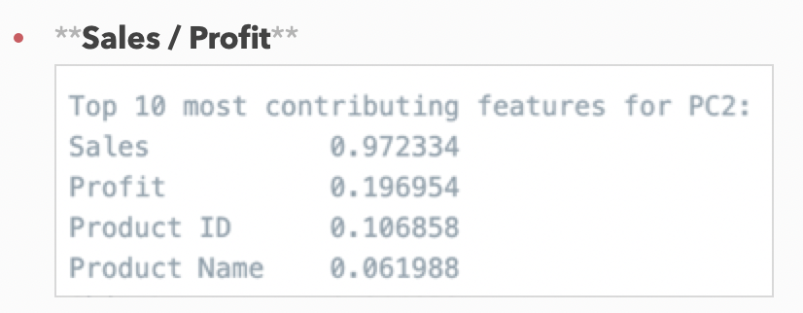
Results - Rough EDA
Feature Selection According to PCA-Based Clustering

Slide 31


Results - Rough EDA
More Preprocessing Required in Scaling Part

Slide 32


Results - FS-EDA
Product: (Sales, Quantity)

Slide 33


Results - FS-EDA
Customer Segmentation

Slide 34


Results - Model Comparisons
By Performance Metrics

Slide 35

Roadmap Evaluation

Slide 36

Roadmap Evaluation
Seasonal Trends

